Slide 1


Ai powered oxygen mask
Venture Viability Analysis
Sri sairam institute of technology tambaram

Slide 2
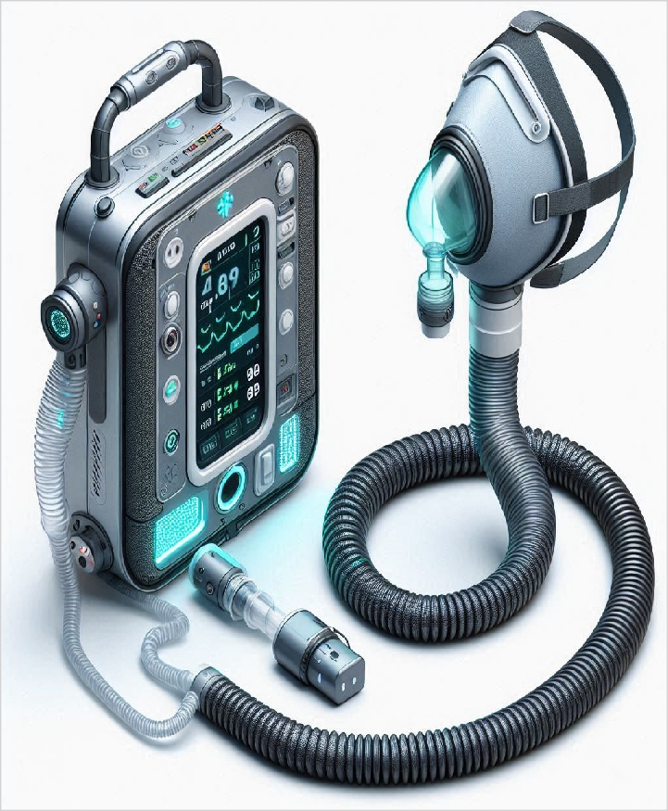
Ai powered oxygen mask
We build AI-powered oxygen masks with nebulizer and stress-relief for smart respiratory care.
Sri sairam institute of technology tambaram

Slide 3
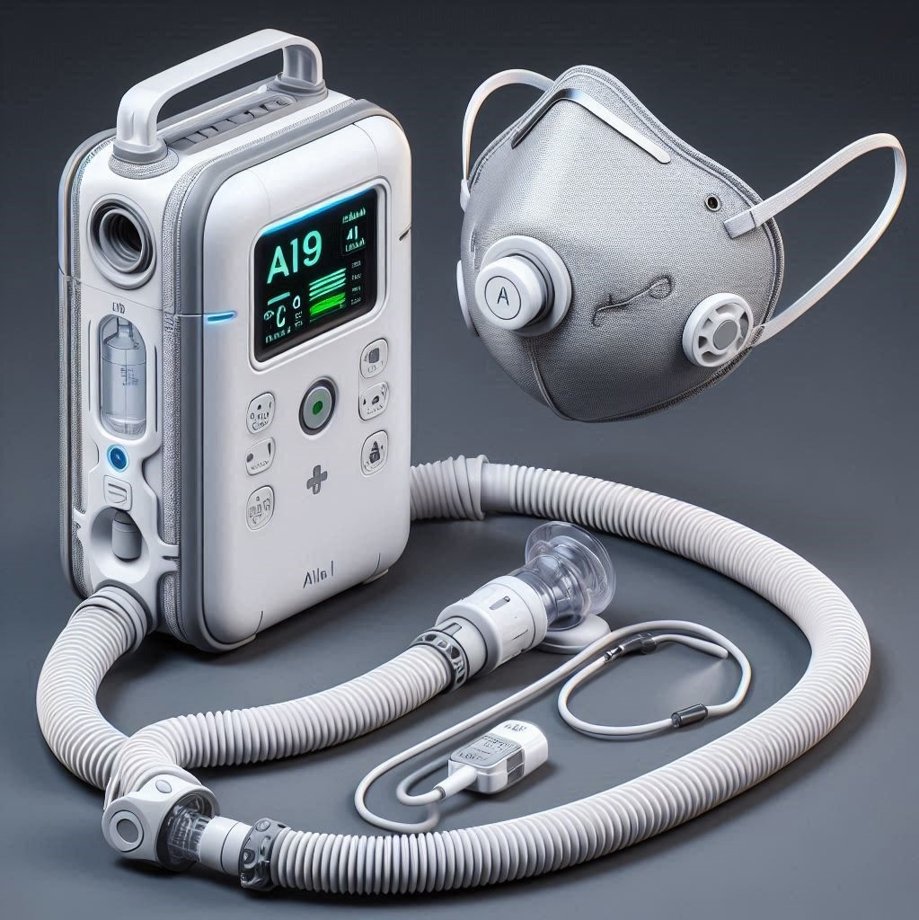
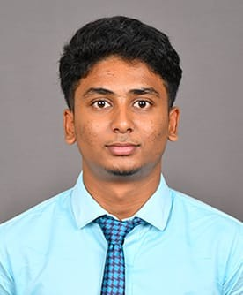
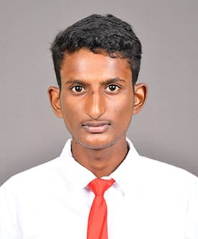

Venture Team
Name: Karthick G
Major: CEO
Name: Sathish
Major: COO
Name: Sharveshwaran.S
Major: CFO
2

Slide 4
Problem Statement
Problem
Clearly define the issue in one sentence. An AI-powered oxygen concentrator designed for trekkers and hill climbers that intelligently adjusts oxygen levels in real-time based on altitude and vital signs to prevent altitude sickness.

Slide 5

Problem Statement/Industry
Supporting Data
Around 85%
Source: World economics forums future jobs
Addresses the risk of altitude-related health issues by providing intelligent, adaptive oxygen support in low-oxygen environments for high-altitude stakeholders.
Area
Health
Industry Pharmaceuticals, Healthcare and Wellness
Domain
Mental Health Services

Slide 6



Problem Analysis
Affected Stakeholders
Society as a whole can be impacted by various issues. For example,
environmental problems like pollution or climate change affect everyone’s
health and future.
Economic struggles, such as unemployment or inflation, can make life harder for families and businesses. Social challenges, including inequality or lack of education, shape
communities.
Impact on Stakeholders
The negative impacts vary based on the problem: Individuals – Suffer emotionally,
physically, or financially.
Example: Poor healthcare leads to increased illness and suffering. Businesses & Organizations – Face losses or operational difficulties. Example:
Small businesses struggle due to economic
downturns. Government & Policymakers – Pressure
t
Root Causes
Some common factors contributing to ongoing problems: Lack of Resources – Insufficient funding, materials, or technology. Systemic Issues – Flaws in policies, education, governance, or infrastructure.
Behavioral & Cultural
Barriers – Resistance to change, misinformation, or societal norms.
Environmental & Economic Factors – Climate change, infl
Personal/Team Connect
Express your motivation and relevance to the issue: Passion & Expertise – If your team is specialized in the field, it drives your dedication.
Personal Experiences – Observing or living through the problem
makes it personal. Future
Impact – Solving the issue can benefit your career, community, or global society.

Slide 7
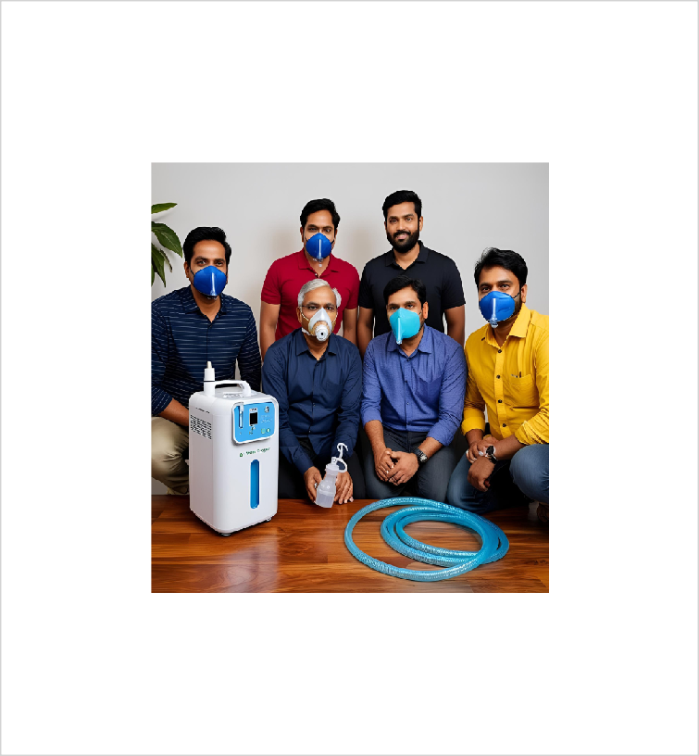
Target Customer Segments
Primary
Adults aged 18-65 with chronic
respiratory issues in urban and semi-urban
areas.
Secondary
Government health agencies and public health organizations
5

Slide 8
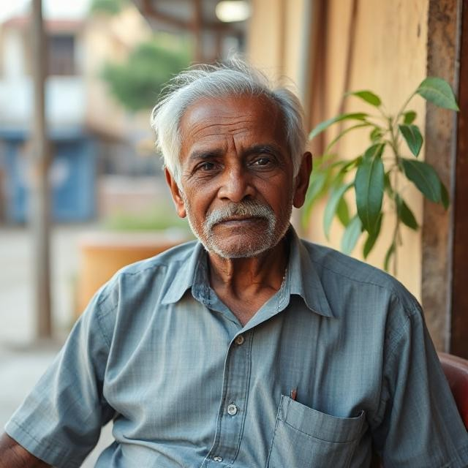
Customer Segment & Persona
Primary Segment
Adults aged 18-65 with chronic respiratory issues in urban and semi-urban areas.
Persona
Secondary Segment
Government health agencies and public health
organizations
Ramesh Kumar Age in years: 55 Location: Suburban
Organizational Role:
{Persona's primary role}
(if applicable)

Slide 9

Jobs-to-be-Done
Functional JTBD
Ramesh Kumar wants to breathe comfortably without bulky equipment, move freely, and access immediate respiratory
support during flare-ups. He seeks
a device that combines oxygen and nebulization, reduces stress, allows independent oxygen
monitoring, and minimizes hospital visits, maintaining his independence in managing his
health.
Emotional JTBD
Ramesh Kumar wants to feel independent and empowered in managing his respiratory health, without being burdened by constant reliance on others or hospital visits. He desires to feel relieved and secure during breathing difficulties, avoiding stress or panic. Additionally, he wants to feel comforted and at ease while going about his daily activities
Social JTBD
Ramesh Kumar desires to gain respect and appreciation from his family and friends for managing his health independently, without constantly relying on others. He wants to avoid stigma related to his respiratory condition, instead appearing active and engaged in social activities. He also seeks to inspire confidence in his
caregivers and loved ones,

Slide 10


Current Alternatives
Current Alternatives
Ramesh Kumar currently uses bulky oxygen tanks, portable concentrators, and separate nebulizer devices for respiratory support. For severe symptoms, he visits hospitals or
consults his doctor. He also uses inhalers for
mild symptoms, but these solutions are cumbersome, limiting his mobility and independence.
Gaps in Current Alternatives
Ramesh Kumar is dissatisfied with current
solutions as bulky oxygen tanks and separate nebulizers limit his mobility. Inhalers offer only partial relief, and frequent hospital visits
disrupt his life. Existing options lack
portability, ease of use, and real-time
monitoring, preventing him from managing his condition independently and comfortably.

Slide 11
Problem Validation (GOOTB)
Partial List of Potential Customers/Users Interviewed
Problem Validation
Total customers/users interviewed:
In-person: 5
Virtually: 7
Total customers/users for whom this problem is important to
solve: 8
Total customers/users who are dissatisfied with the current alternatives: 6
Name: Ravi Kumar
Occupation: Retired Clerk
Name: Anjali Sharma
Occupation: IT Employee
Name: Vikas Reddy
Occupation: Proffessor

Slide 12
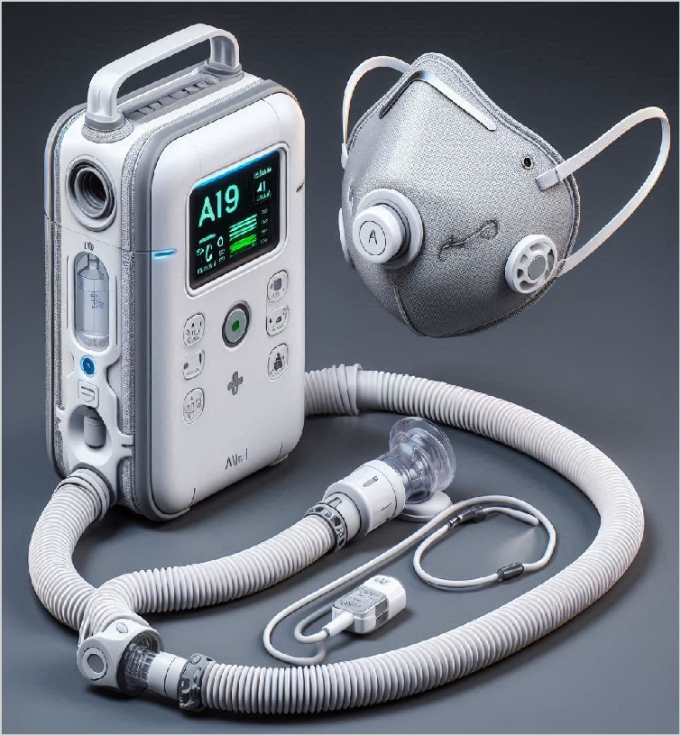
Our Solution
Solution
AI powered Oxygen Mask : Monitors and provides flow of oxygen based on oxygen concentrator method with the help of AI
Core Technologies/ Methodologies
Embedded systems, AI/ML, IoT, medical-grade
concentrators, Flutter app, Firebase, AWS cloud for real- time health tracking and analytics.
6

Slide 13

Solution Design
Our Solution
Key Features
Our AI-powered oxygen mask features real-time oxygen
delivery, stress-reducing mode,
nebulizer integration, health monitoring, mobile app sync, and emergency alerts.
Uniqueness
AI-integrated oxygen delivery system with stress-reduction, nebulization, portable design, and real-time health insights via a proprietary app.
An AI-powered portable oxygen concentrator that monitors real-time conditions and vital signs to automatically adjust oxygen delivery for users in high-altitude environments.
Solution Format:
Physical Product + Digital Service
Core Technologies/ Methodologies:
Embedded systems, AI/ML, IoT, medical-grade concentrators, Flutter app, Firebase, AWS cloud for real-time health tracking and analytics.

Slide 14

Solution Benefits
Functional Benefits
Users gain faster workflows, real-time
insights, reduced errors, cross-platform access, and improved decision-
making—boosting productivity, saving time, and streamlining operations efficiently.
Emotional Benefits
Users feel confident, empowered, and stress- free with a reliable, secure solution that
simplifies tasks, builds
trust, and offers a smooth, satisfying experience that
supports their goals and growth.
Social Benefits
Users gain better collaboration, enhanced communication, increased transparency, and stronger community engagement—fostering teamwork, shared success, and a more connected, inclusive
working
Macro Benefits
Our solution will impact
**society** by improving access to
efficient tools,
**economy** by boosting productivity and reducing operational costs, and
**ecology** by
minimizing resource waste

Slide 15


Competitors
Direct
Philips India, Inogen ResMed, Caire Inc.
Indirect
HealthifyMe, Breathe Easy India Xiaomi Mi Air Purifiers, Withings
Our UVP
AI-powered oxygen concentrator with nebulizer, stress- reduction mode, portable, affordable
7

Slide 16

Competitors
Direct Competitors
Philips India, Inogen
Indirect Competitors
HealthifyMe, Breathe Easy India
Direct Competitors Globally
ResMed, Caire Inc.
Indirect Competitors Globally
Xiaomi Mi Air Purifiers, Withings

Slide 17
Macro Analysis
Favourable Trends
AREA | DESCRIPTION
Technology | AI & IoT enable smarter, real-time health monitoring in medical devices.
Climate/Environment | Urban air pollution boosts demand for portable respiratory health solutions.
Unfavourable Trends
AREA | DESCRIPTION
Economy | Increasing costs of medical-grade components may raise product prices and reduce margi
Other | Stringent medical device approvals may delay product launch and scale-up.
Data Sources:
IBEF Medical Devices Industry Report 2023 India Regulatory Guidelines by CDSCO (Central Drugs Standard Control Organization)

Slide 18
Prototype
Functionality included in the Prototype
Simulated AI oxygen flow and nebulization with indicator lights.
Functionality NOT included in the Prototype
Real-time health tracking and mobile app integration.

Slide 19
Prototype Validation
Number of users engaged with?
7
How many people liked or loved the prototype?
5
How many people were either neutral or mostly unhappy with the
prototype?
2
Prototype Feedback
What aspects of the prototype did the users LOVE? Users appreciated the intuitive control panel and clear labeling, which simplified operation and reduced training needs. The compact and ergonomic design enhanced portability, making it easier to use in daily activities. | What aspects of the prototype were DISLIKED by the users? Some users found the device's noise level during operation to be a concern, as it impacted comfort, especially during prolonged use.

Slide 20
Competition Analysis
COMPETITOR NAME | TYPE | STRENGTHS | WEAKNESSES
Walnut Medical | Direct | government and military hospitals | with less emphasis on consumer prod
Helix Private Limited | Direct | provides training to biomedical | Does not specialize in oxygen mask
Philips Respironics | Direct | Lightweight, long battery life | High cost, expensive batteries
Inogen | Direct | Portable, mobile app integration | High price, limited flow
Our Product/Service will be better than the competitors' solutions because:
Our device combines oxygen delivery with nebulization, eliminating the need for separate equipment and enhancing treatment efficiency.

Slide 21

Market Size
Total Addressable Market (TAM)
USD 1.7 billion
Serviceable Available Market (SAM)
213.8 million by 2030, growing at a CAGR of 7.2%
Serviceable Obtainable Market (SOM)
25,00,00,000
TAM
SAM
Assumptions
Geography: Targeting India, a rapidly growing market for oxygen concentrators. Demographics: Focusing on adults aged 18–65 with chronic respiratory issues, particularly in urban and semi-urban areas. , 90000,
3000
SOM
Sources of Research
Market Research Future (MRFR), 2024

Slide 22
Revenue Models / Pricing
Revenue Model (Primary)
Freemium Model
Revenue Model (Secondary)
Licensing Model

Slide 23



Lean Canvas
Problem Clearly define the issue in one sentence. Example: Plastic waste is overwhelming our environment, with few effective recycling solutions. | Solution Portable Air Purifier Mask – A wearable mask with air filtration, providing clean air on-the-go, with adjustable filters based on pollution levels, for individuals with chronic respiratory issues | Unique value Proposition AI-powered oxygen concentrator with nebulizer, stress- reduction mode, portable, affordable |  | Unfair Advantage Proprietary AI algorithm, dual-mode oxygen + nebulizer, rural healthcare partnerships, and early market access. | Customer Segment Adults aged 18-65 with chronic respiratory issues in urban and semi-urban areas. ,Government health agencies and public health organizations
 | Key Metric Units sold, app usage, oxygen accuracy, uptime, repeat users, and customer satisfaction (NPS). |  |  | Channels Direct website sales, Amazon, Flipkart, IndiaMART, hospitals, clinics, and rural health programs.
Cost Structure Hardware, AI development, testing, logistics, certifications, customer support, and marketing. |  |  | Revenue Streams Freemium Model, Licensing Model

Slide 24
Go-to-Market Approach
Geographic Focus
Top 5 Indian metros + rural Tamil Nadu, expanding later to Karnataka and Maharashtra
Digital Marketing Channels
Google Ads, Instagram, Facebook, YouTube, LinkedIn, SEO, Email Marketing, Affiliate
Marketing
Marketing KPIs
CAC, CLV, Conversion Rate, Revenue Growth, App
Engagement, Lead-to-
Customer Ratio, Churn Rate
PRIMARY CUSTOMER SEGMENT
Adults aged 18-65 with chronic respiratory issues in urban and semi-urban areas.
Physical Marketing
Channels Health expos, Newspaper ads, Hospital flyers, Trade shows,
Event sponsorships, Pop-up
booths, Direct mail
UVP
AI-powered oxygen concentrator with nebulizer, stress-reduction mode, portable, affordable
Competitors' GTM
Competitor #1 uses YouTube influencers well but lacks
print ads; Competitor #2 runs
strong radio campaigns but weak online presence
GTM Partners
Healthcare influencers, Digital marketing agencies, Event organizers, Hospital networks, Content creators

Slide 25

Sales & Customer Service
Customer Service
Website live chat, Phone support, Email, WhatsApp, Social media DMs, Zendesk integration
Distribution Channels Direct website sales, Amazon, Flipkart, IndiaMART, hospitals, clinics, and rural health
programs.
Physical Sales Channels Reliance Retail, CII expos, IITF, Auto Expo, Hospital partnerships, Medical trade fairs
PRIMARY CUSTOMER SEGMENT
Adults aged 18-65 with chronic respiratory issues in urban and semi- urban areas.
Digital Sales Channels Amazon, GeM, IndiaMART, Instagram, TradeIndia, Udaan,
Website
Sales KPIs
Revenue growth, Conversion rate, CAC, Sales cycle time, Customer retention, Lead-to- customer ratio
UVP:
AI-powered oxygen concentrator with nebulizer, stress-reduction mode, portable, affordable
https://www.instagr am.com/ai_powere d_._oxygen_mask/?
pwa=1#
GTM Partners
Digital: NPS, CSAT, Google Forms surveys Offline: Feedback cards, Telephone surveys, In-depth interviews, FGDs
am.com/reel/DJops Q1pKKQ/?
utm_source=ig_we b_copy_link&igsh= MzRlODBiNWFlZA=

Slide 26
Financials
Revenue Models/Streams
Freemium Model Licensing Model
First Year Projections
Revenues: ₹3,60,000
Pricing
Operating Profits:
₹36,000
Unit of Sale: Portable Oxygen Mask
Selling price per unit:
₹30,000 for each unit
9

Slide 27
Revenue Models / Pricing
Revenue Model (Primary)
Freemium Model
Unit of Sale
Portable Oxygen Mask
Sale Price per Unit
₹30,000 for each unit
Expected units to be sold in Year 1
Expected Sales : 50 Units
Expected growth in monthly sales
10% growth rate

Slide 28
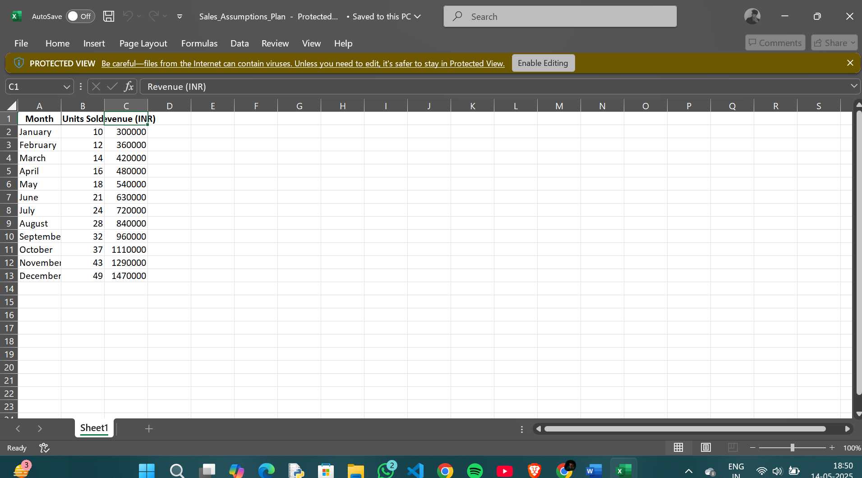
Costs & Revenues: Key Assumptions

Slide 29
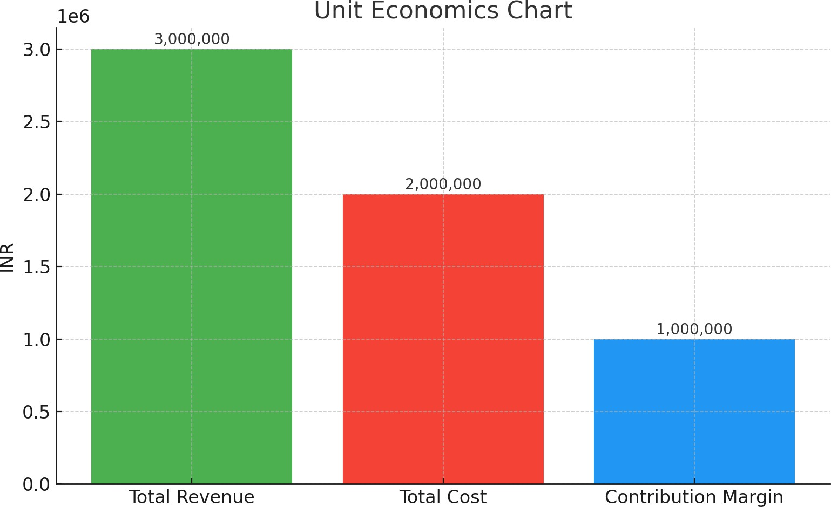
Performance & Break-Even Analysis
Year 1 Revenues ₹3,60,000 | Gross Profits for Year 1 ₹2,10,000
Net Profits for Year 1 ₹36,000 | Break-even Month Month 11

Slide 30

Next Steps
Venture Viability Index: 53.33%
Goals for Months 10-12
500+ customers, optimize customer service
Goals for Months 7-9
Scale marketing, expand to more cities
Goals for Months 4-6
Refine product, begin small-scale
sales
Goals for Months 1-3
Launch MVP, test with pilot
users,collect
feedback
10

Slide 31
Venture Viability Assessment
Venture Viability Index
53.33%
Strengths
Unique AI-based health device, strong margins, and multi-channel sales.
Areas of Improvement
Need faster customer adoption, better early marketing, and stronger support systems.

Slide 32
Next Steps
TIMELINE | GOALS | TEAM NEEDED | PHYSICAL RESOURCES NEEDED | FUNDS NEEDED
Months 1-3 | Launch MVP, test with pilot users,collect feedback | 2 | Laptops,TU | 1,50,000
Months 4-6 | Refine product, begin small-scale sales | 3 | demo kits | ₹2,00,000
Months 7-9 | Scale marketing, expand to more cities | 3 | Travelcost | ₹3,00,000
Months 10- 12 | 500+ customers, optimize customer service | 3 | prototype | ₹4,00,000

Slide 33
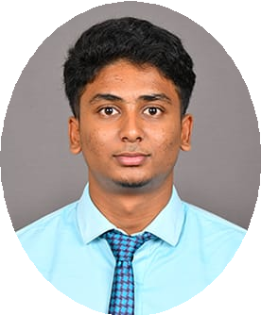
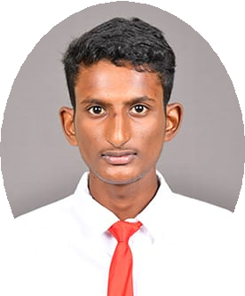

Venture Team
Name: Karthick G
University/College: Sri Sairam Institute Of Technology
Major:CEO
Key Skills: Communication Skills Role in the Venture: Representative Keen on continuing with the venture: Yes
Name: Sathish
University/College: Sri Sairam Institute Of Technology
Major:COO
Key Skills: ML Pattern Analysis
Role in the Venture: Executive Chief Keen on continuing with the venture: Yes
Name: Sharveshwaran.S
University/College: Sri Sairam Institute Of Technology
Major:CFO
Key Skills: Presentation Skills
Role in the Venture: Idea Coordinator Keen on continuing with the venture: Yes
Current Mentors:
Dr.D.MurugaRadhaDevi Mr.R.Sampath
Mentors Needed in these Areas:
Mentoring in technology, product development, AI integration, and marketing

Slide 34


Venture Summary
Mission
To innovate AI-powered oxygen concentrators with
nebulization, offering portable, efficient, and stress- reducing oxygen support. Our goal is to improve respiratory health and well-being, making it
accessible and effective for individuals in low-oxygen
or high-pollution environments.
OVERVIEW
Our venture focuses on revolutionizing respiratory care with AI-powered
oxygen concentrators that integrate
nebulization and stress-reduction
features. We aim to provide a portable, efficient solution for individuals with
respiratory conditions or those exposed to polluted environments, improving
their quality of life through advanced technology.
Social/Economic Relevance
Respiratory issues and stress-related conditions are rising globally. Our solution provides a compact, efficient way to deliver oxygen and reduce stress, addressing the needs of people with respiratory
conditions or living in polluted areas, especially
where traditional treatments are unavailable.
2

Slide 35
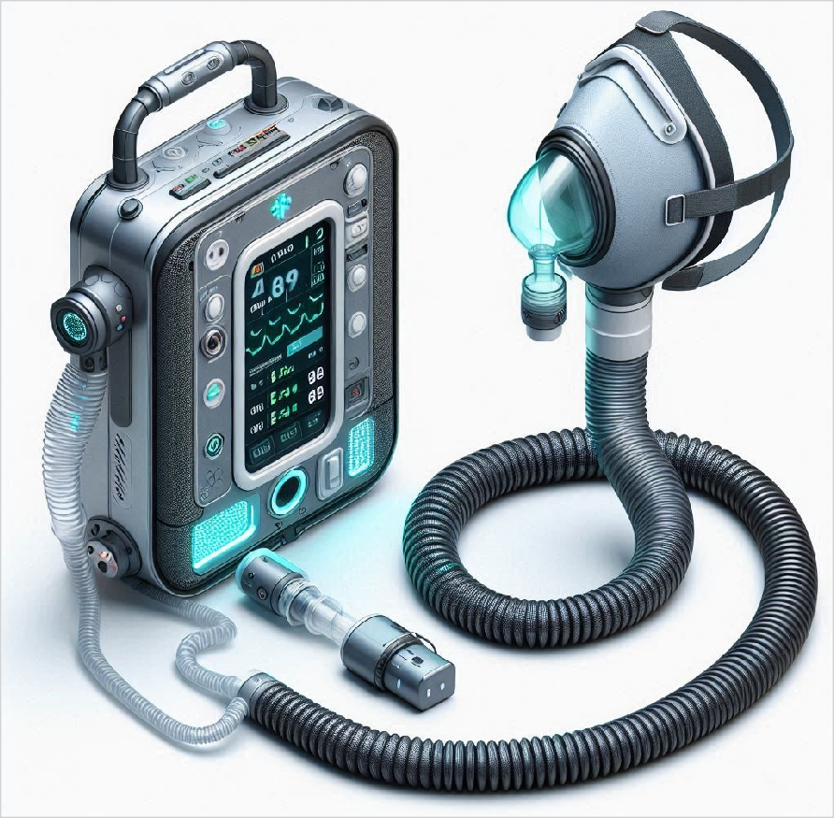
Thank
You!
To innovate AI-powered oxygen concentrators with nebulization, offering portable, efficient, and stress-reducing oxygen support. Our goal is to improve respiratory health and well-being, making it accessible and effective for individuals in low-oxygen or high-pollution environments.

